Slide 1
Market and Market Revenue
By: Nisham Gautam & Lavya Udash

Slide 2
Contents
S.N | TOPICS
1. | Introduction of market
2. | Importance of Market
3. | Types of Market
4. | Market revenue
5 | Revenue in different market structure
6 | Factors influencing market revenue

Slide 3
01
Introduction

Slide 4
Introduction to Market
A market is a place where buyers and sellers come together to exchange goods, services, or resources.
It helps to determine prices based on supply and demand, allowing people to trade what they need or want.
The major objective of market is to earn profit

Slide 5
Importance of Market
Engaged in trade
Proper use of resources
Economic growth
Multiple choices
Employment opportunities

Slide 6
1. Perfect Competition 2. Monopolistic Competition 3. Oligopoly 4. Monopoly
Types of Market

Slide 7
1. Perfect competition market
Many buyers and sellers
Homogeneous product
Free entry and exit
No competition
Perfect information of market
Example: Agriculture market like wheat

Slide 8
2. Monopoly Market
Single seller
Unique product with no close substitute goods
High barriers to entry
Significant control over price
Example: Nepal Electricity Authority, Nepal Oil Cooperation.

Slide 9
3.Oligopoly
Few number of sellers
Products maybe homogeneous or differentiated
High barriers to entry
Example: Cement Industries, Gas companies, Automobiles , Televisions, etc.

Slide 10
4. Monopolistic Market
Many seller
Differentiated product
Realistic concept
Example: Hotel ,salon ,etc.

Slide 11
Introduction to market revenue
Market revenue refers to the total income generated from sales within a particular market.
Formula: Revenue = Price × Quantity Sold

Slide 12
Revenue in different market structure
Perfect Competition Market:
Revenue: Total Revenue (TR) is calculated as Price (P) × Quantity (Q). Since price is constant, marginal revenue (MR) equals price.
Monopoly Market:
TR increases with quantity but at a decreasing rate due to the downward-sloping demand curve. MR is

Slide 13
Monopolistic Market:
Similar to a monopoly but with more elastic demand. TR increases at a decreasing rate, with MR below price.
Oligopoly Market:
A few firms dominate the market. Revenue depends on the strategic interactions between firms, including pricing strategies and output levels

Slide 14
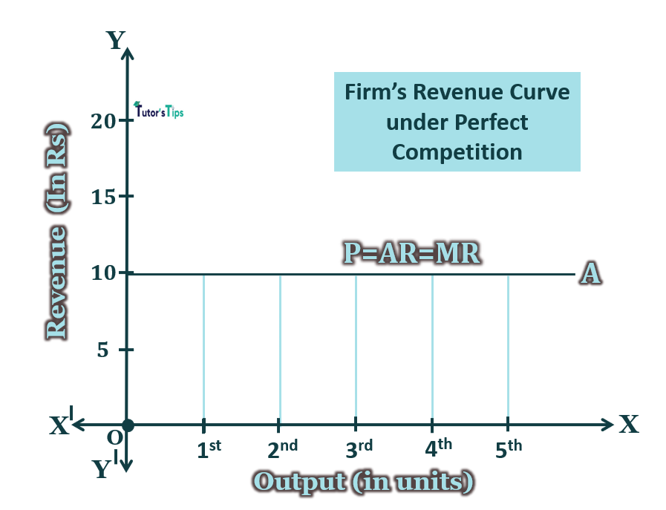
Revenue Curves in Different Market Structures Perfect competition market:

Slide 15
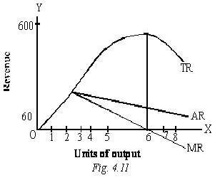
M0nopoly Market

Slide 16
Table: Global Market Revenue in Key Industries (2023)
Industry | Revenue (in Billion USD) | Market Type
Technology (Smartphones) | 400 | Monopolistic Competition
Automobile | 2,500 | Oligopoly
Utilities | 500 | Monopoly
Agriculture | 200 | Perfect Competition

Slide 17
Factors Influencing Market Revenue
Price of goods and servies
Demand
Competition
Consumer preferences
Cost of production
Technology
Season

Slide 18
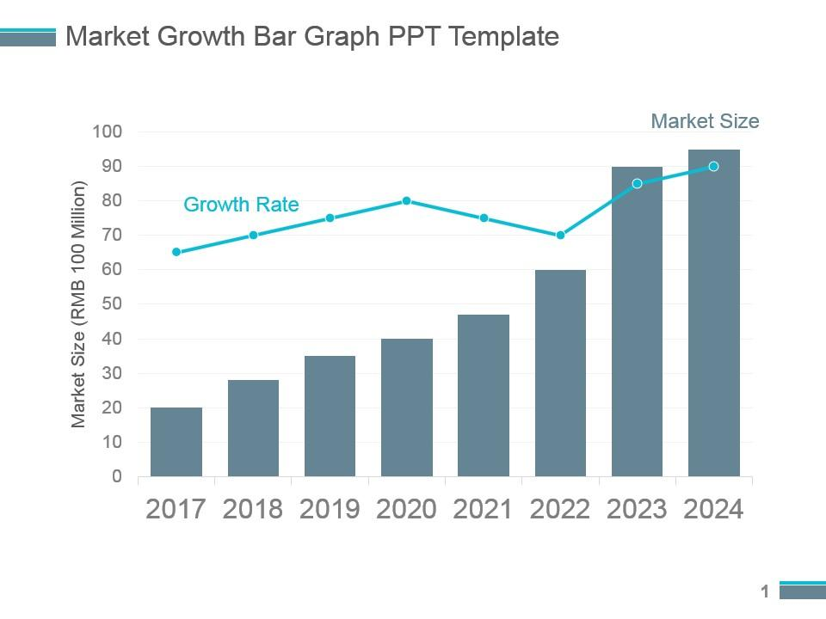
Market Revenue Trends Over the Last Decade

Slide 19
Conclusions
In conclusion, markets are essential for the economy, as they determine prices and allocate resources efficiently. Different market structures—like perfect competition, monopolistic competition, oligopoly, and monopoly—affect how companies set prices and generate revenue. Understanding these dynamics helps businesses and policymakers make better decisions to optimize outcomes in various industries.

Slide 20


